Slide 1
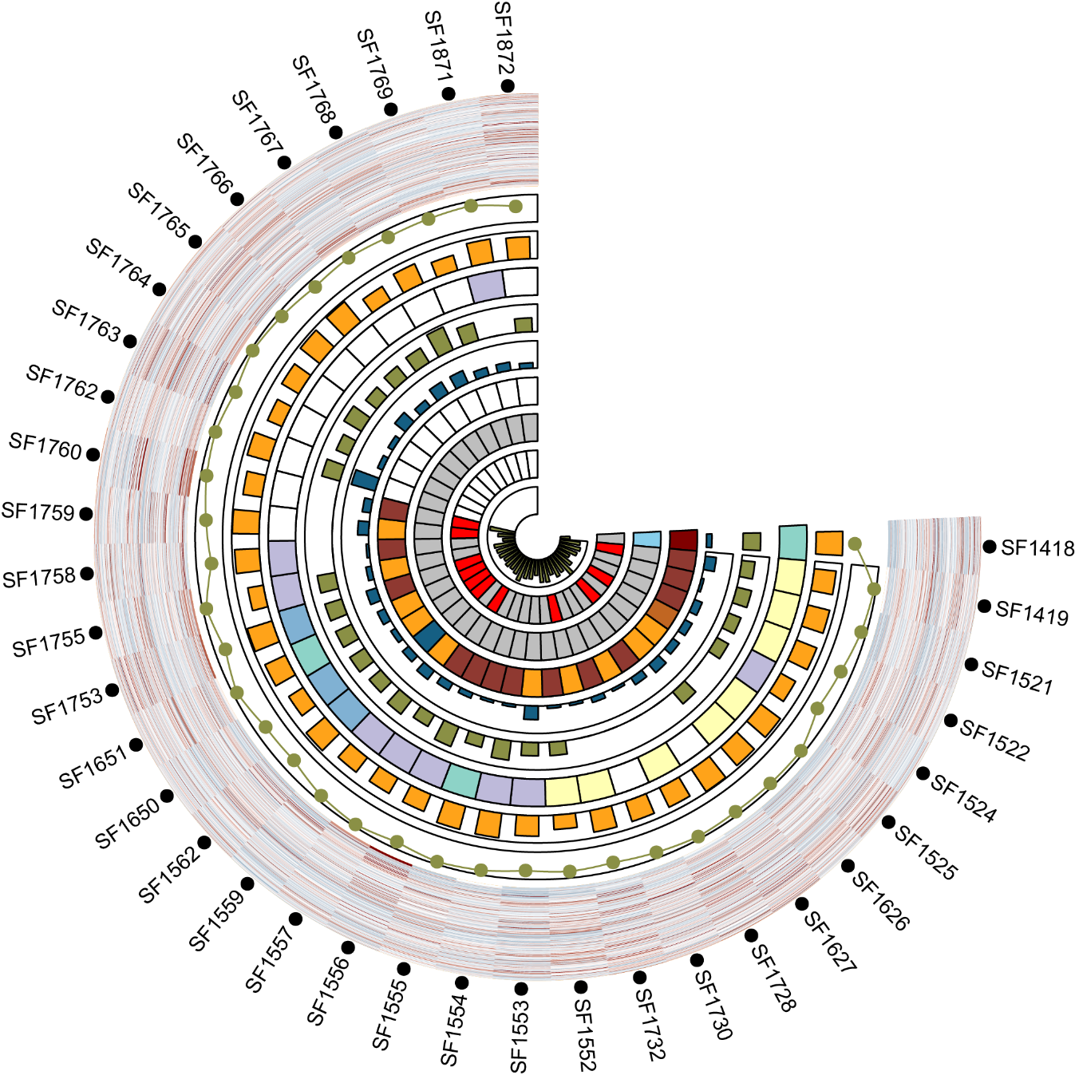
Patient information (sample collection)
Notes:
Birth GA – sample GA
Birth GA < 39
Birth GA > 39

Slide 2
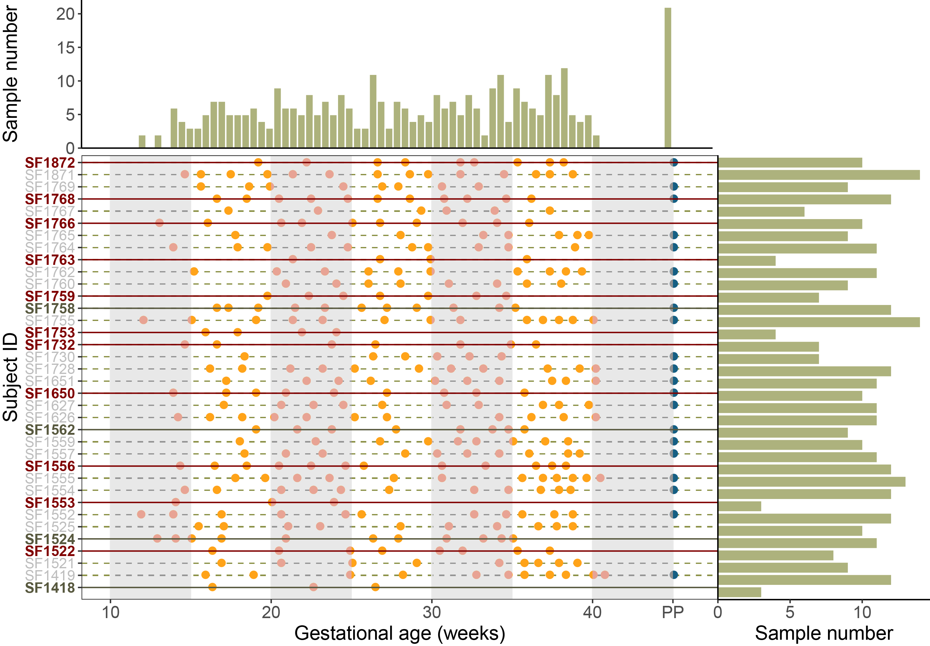
Patient information (sample collection)
Notes:
Birth GA – sample GA
Birth GA < 39
Birth GA > 39

Slide 3
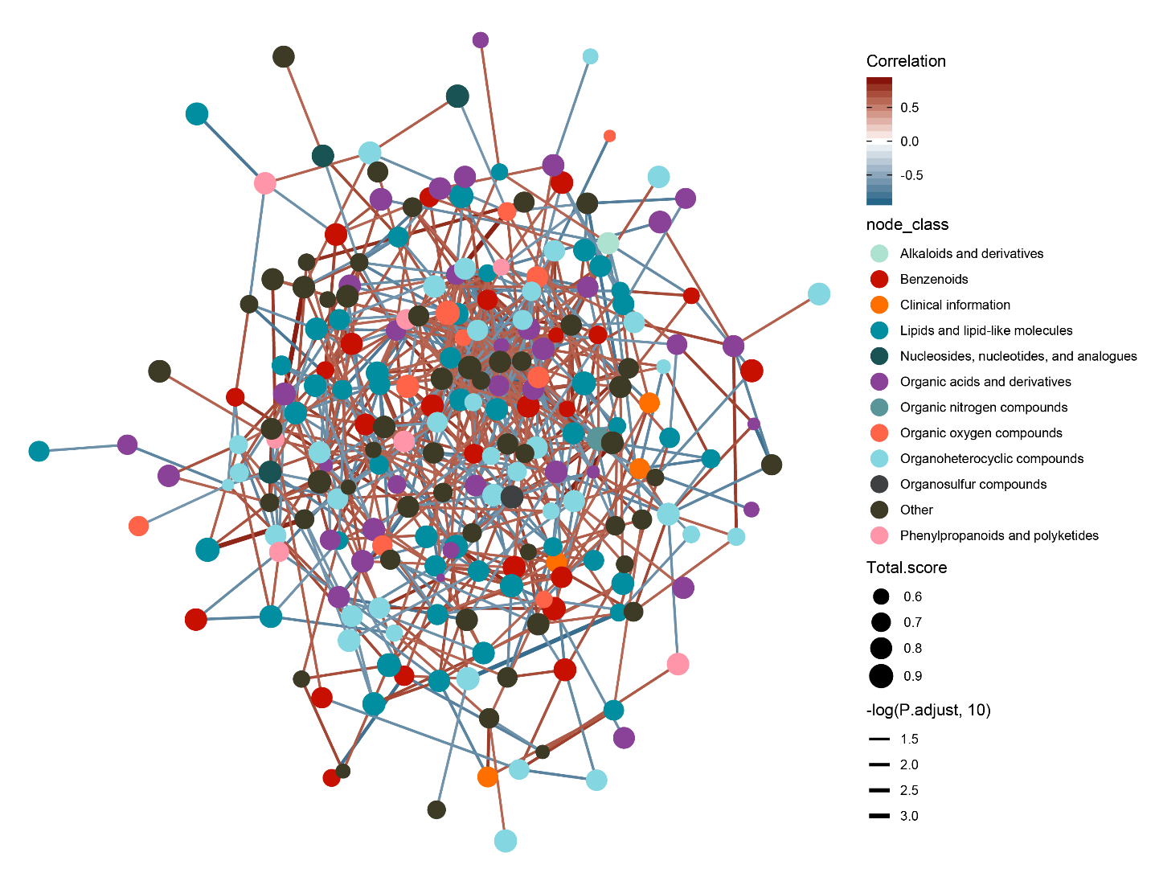
Whole cross-sectional correction network
222 vertexes
841 edges
Spearman correlation:
Correlation > 0.5 or Correlation < -0.5
P_{adjust} < 0.05

Slide 4
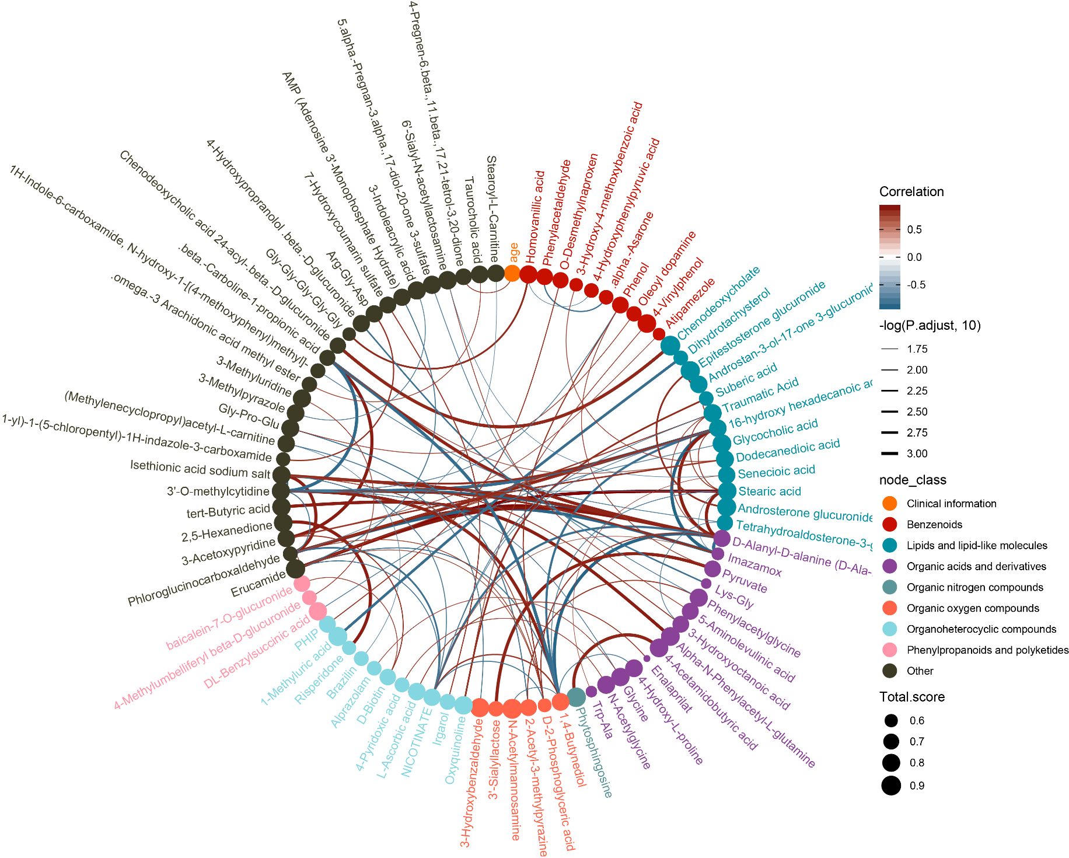
Top 100 correlations of cross-sectional correction network

Slide 5
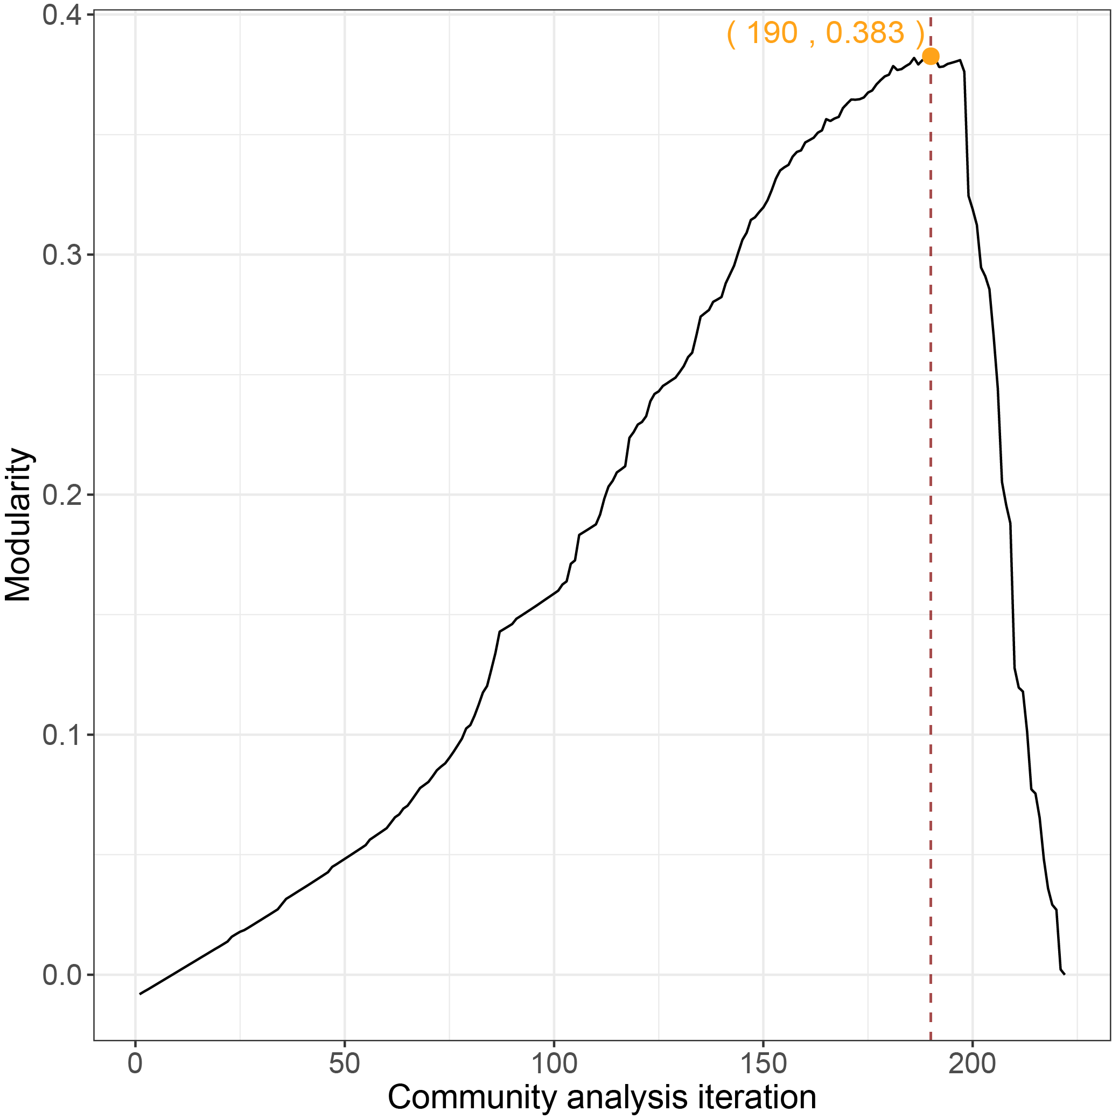
Subnetwork detection using community analysis
Modularity is 0.383 at 190 iteration

Slide 6
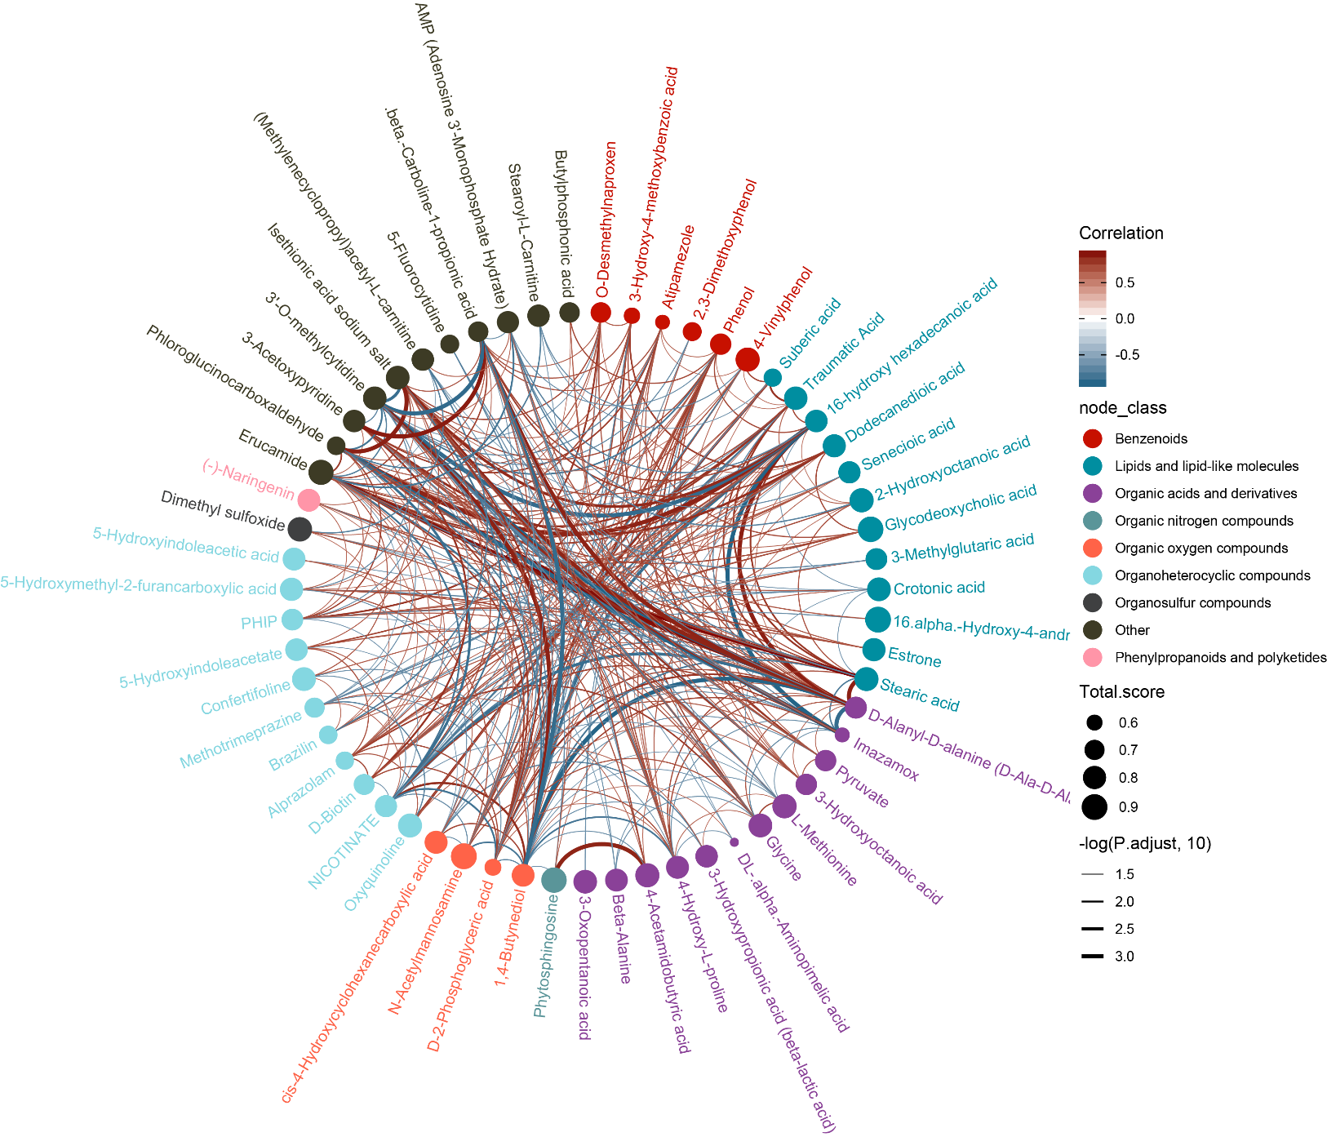
Cross-sectional subnetwork 7

